Slide 1
A Beautiful Seascape
Project Presentation

Slide 2


TEAM
Batch 66 – A
Towhidur Rahman Siam
Md. Tasriful Hoque Mozumder
CSE 066 07674
CSE 066 07652

Slide 3
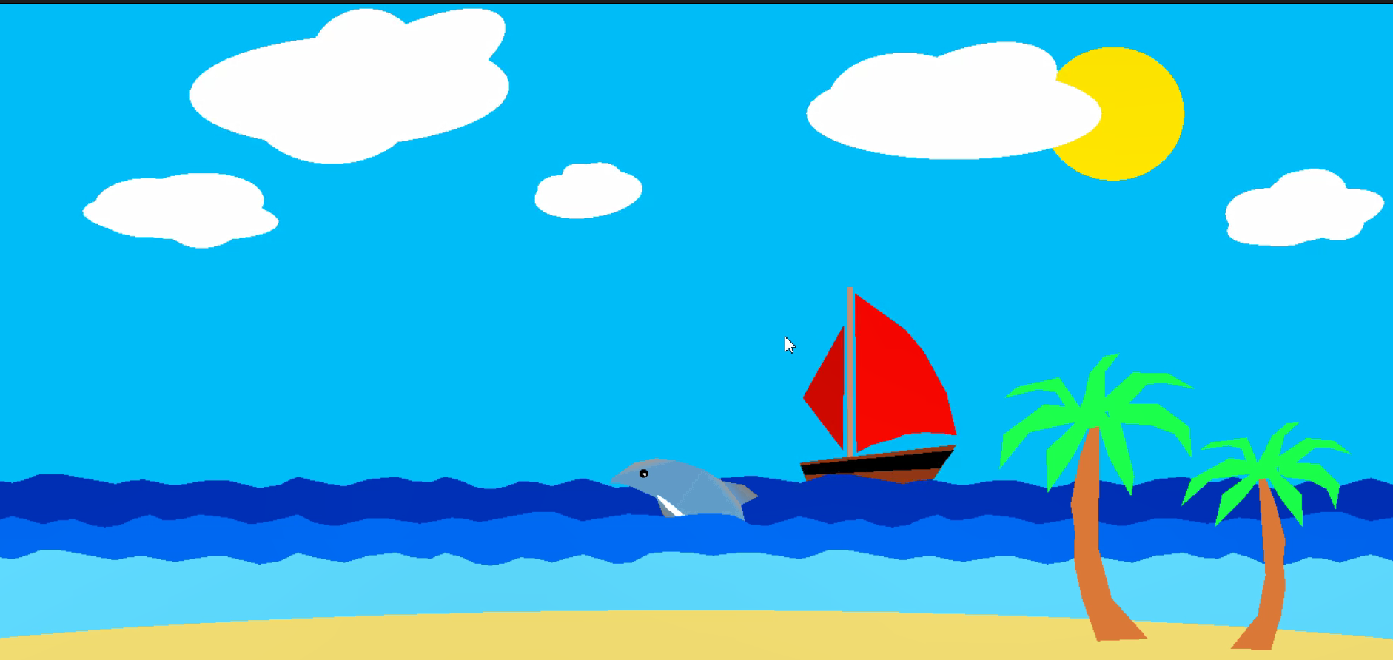
ABOUT
A Beautiful Seascape
A scenario of sea along with dolphin, tree, cloud, sun , speed boat etc. The dolphin animated like floating and sinking.

Slide 4

Our Journey
Firstly, we thought out the whole scenario.
Then we listed all the elements. Simple elements were designed using circles and polygons . But for the complex objects , we took a desired object from Google transported them on online graph.
Finally, we took the values of the points and applied those using polygon in our program. Moving objects like dolphin took us very difficult to figure out. But, we did managed to do it by combining circular and linear movement.
However doing the project was very fun and interesting. We really enjoyed the short journey.

Slide 5
Thank You

